Slide 1


A Research Topic Evolution Prediction Approach
Based on Multiplex-graph Representation Learning
Yang Zheng¹, Kaiwen Shi², Yuhang Dong^{1,} XiaoGuang Wang³ and Hongyu Wang¹*
¹(School of Management, Wuhan University of Technology)
²(School of Information Engineering, Zhongnan University of Economics and Law)
³(School of Information Management, Wuhan University)
hongyuwang@whut.edu.cn
iConference 2024
Workshop of the 5th Extraction and Evaluation of Knowledge Entities from Scientific Documents
and the 4th AI + Informetrics

Slide 2
Contents
1、Research Background & Questions
2、Analysis Dimension & Methodology
3、Experiment Design & Results
4、Conclusion

Slide 3
1 Research Background
The volume of sci-tech literature is expanding and the requirements of information analysis is more complex and diverse.
Large Volume sci-tech Data proposed new challenges to the topic evolution analysis.
How to reveal and predict the evolution trends of research topics automatically and intelligently?
4 kinds of topic evolution analysis methods in existing research
Expert judgement
①Qualitative analysis of research topic trends based on expert experience is subjective.
②Calculating evolution trends with specific indicators have difficulties when faced with multiple and high-dimensional variables.
③Based on the machine learning algorithm, regression and classification tasks are performed to analyze the sci-tech development trends.
④Deep representation learning is powerful to model the sci-tech entities and their relationships.
Statistical analysis
Machine learning
Deep
learning

Slide 4
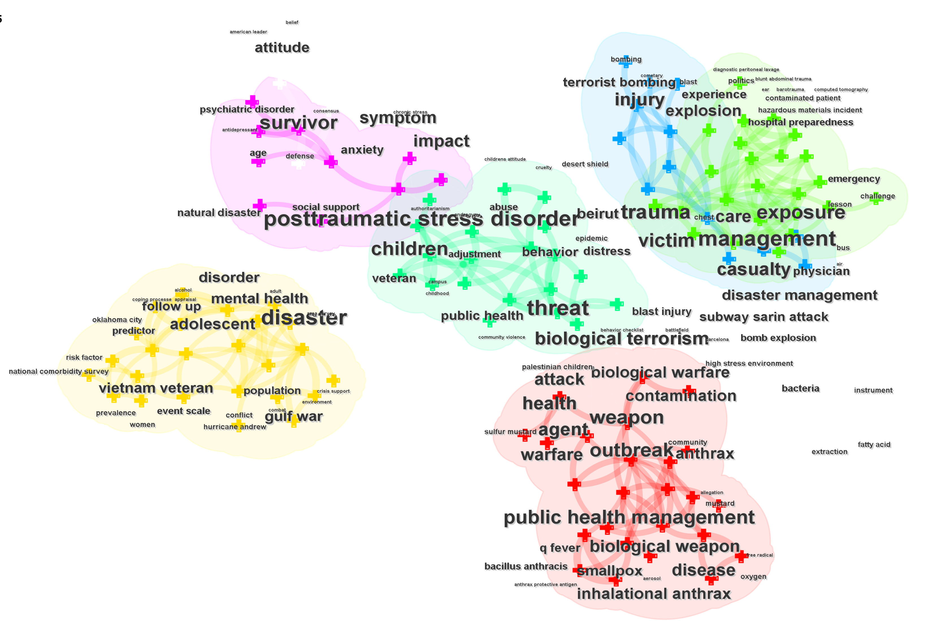
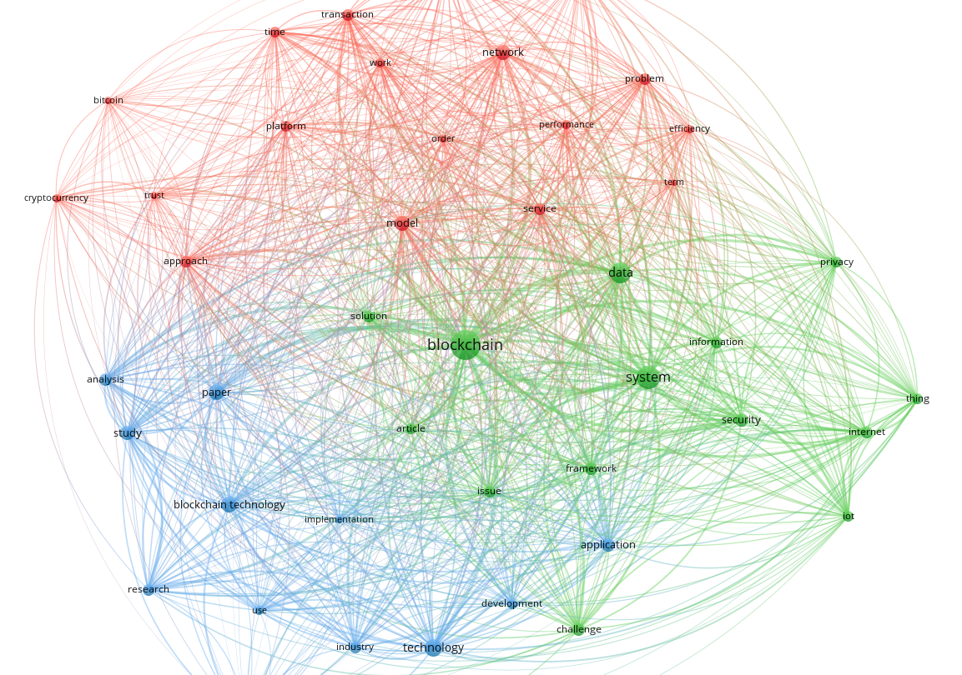
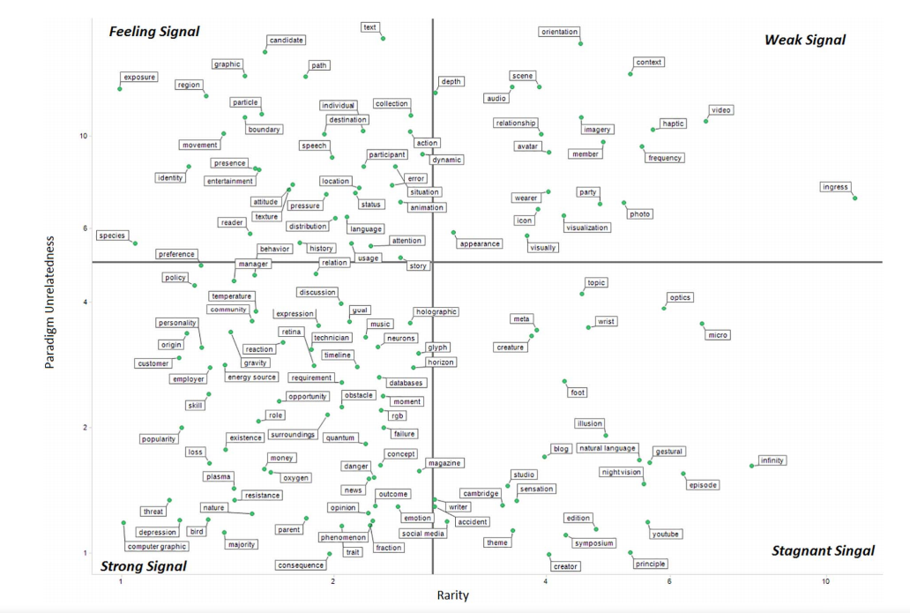
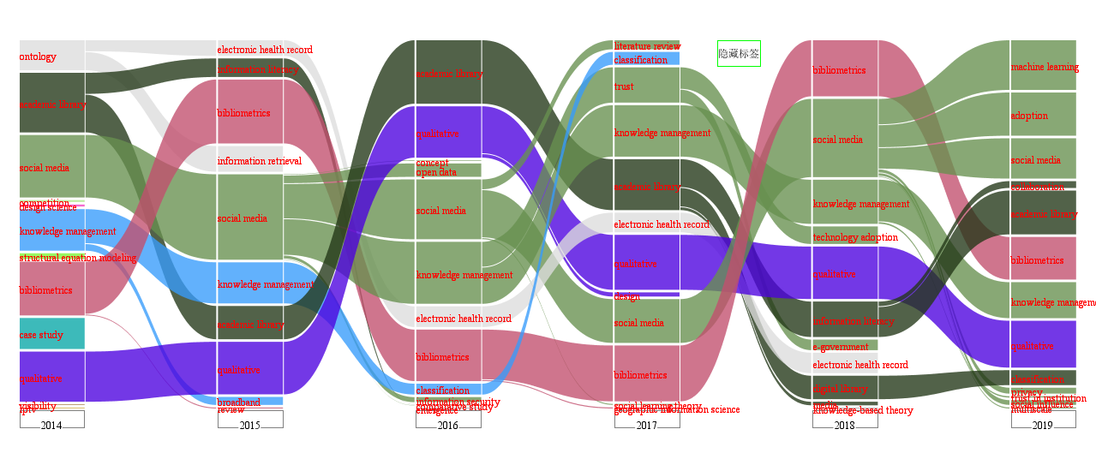
1 Research Background
2 kinds of topic evolution presentation methods
Indicators Change
①Use specific indicators to describe the process of topic evolution, such as disruptive, burst, and others. Fundamental statistical charts and composite charts are used to present the indicators.
②There are commonly used visualization tools in topic evolution presentation, such as CiteSpace, VOSViewer, self-developed NEViewer …
Evolution
Visualization
CiteSpace
VOSViewer
Composite
Chart
NEViewer

Slide 5
Research Questions
The two main research questions are as follows:
RQ1: How to reveal the evolution process of topics at the micro level, thereby tracking the fine-grained evolution trends of research topics?
RQ2: Whether the prediction of topic evolution trends become more accurate after tracking multi-dimensional evolutionary features? (the detail will be shown in the next slide)
Notes:
Slide

Slide 6
2.1 Analysis Dimensions of Topic Evolution Prediction
In order to address the two research questions, graph learning models will be introduced in this study:
Graph learning can model the evolutionary features more multidimensional
Fit nonlinear relationships, automatically extracting entity feature.
Capture the dynamic accumulation effect of entity nodes in complex networks.
Knowledge discovery on large -scale scientific knowledge networks.
Model and fusion multi-dimensional feature to predict the research topic evolution trends.
The evolution analysis of research topics in specific field is usually approached from three dimensions*:
content
Focus on the dynamic changes of related topics in their semantic space in adjacent time windows.
According to the network features, the evolution patterns of topics such as expansion, contraction, merging, splitting … are analyzed through the structure change of knowledge networks.
structure
strength
Referring to the descriptive indicators changes that can be quantified in the research topic, such as the attention to the topic, research hotness, scale, and influence.

Slide 7
2.2 The Framework of Topic Evolution Prediction Approach
The framework of this study can be divided into three steps.

Slide 8
2.3 Implementation Steps of Topic Evolution Prediction
Step1: Data preparation
Collect literature data in the field of “information science” from Web of Science.
After that, process the data by null-data validation, words camel naming, etc.
Construct basic data by extracting meta data, such as title, abstract, keyword and citation relationship in the reference list.

Slide 9
2.3 Implementation Steps of Topic Evolution Prediction
Step2: Multi-dimensional data representation
Content: Generate word vector for terms, calculate the semantic distance between the terms to obtain the semantic content feature.
Strength: Extract the term frequency, and obtain the term frequency strength feature. (i.e. Hotness)
Structure: Map the citation relationship between literature to the relationship of terms to obtain the citation structure feature.
semantic content
citation structure
term frequency strength

Slide 10
2.3 Implementation Steps of Topic Evolution Prediction
Step3: Topic evolution prediction
Multiple knowledge network
Use GCN/GAT to conduct structure and content representation respectively.
Concating the representation vectors of the three dimensions respectively for feature fusion (content, structure, strength), use MLP to predict the term frequency strength (representing the prediction of the topic evolution hotness) at the next period.
Finally, construct 4 groups of ablation experiments to test the performance of the topic evolution prediction in different cases.

Slide 11
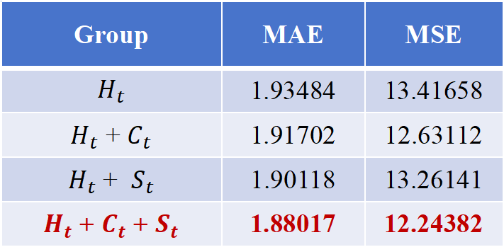
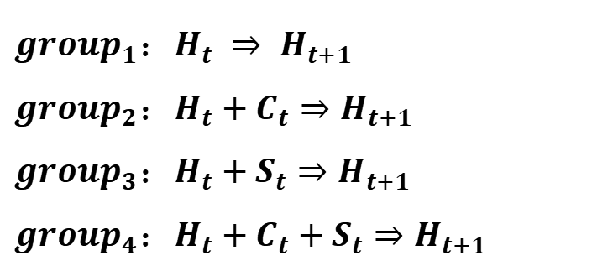
3 Experiments and Results of Topic Evolution Prediction
The results of the experiments are as follows:
Result 1: Test evaluation of predicted value and true value.
Ablation Experiment
Group | MAE | MSE
$$H_{t}$$ | 1.93484 | 13.41658
$H_{t}$ + $C_{t}$ | 1.91702 | 12.63112
$H_{t}$ + $S_{t}$ | 1.90118 | 13.26141
$H_{t}$ + $C_{t}$ + $S_{t}$ | 1.88017 | 12.24382
$${group}_{1}：H_{t} ⇒ H_{t+1}$$
$${group}_{2}：H_{t}+C_{t}⇒H_{t+1}$$
$${group}_{3}：H_{t}+S_{t}⇒H_{t+1}$$
$${group}_{4}：H_{t}+C_{t}+S_{t}⇒H_{t+1}$$
The frequently-used indicators in regression task, MAE (Mean Absolute Error) and MSE (Mean Square Error) are selected to evaluate the prediction performance of each groups in this study.
Compare with the baseline, which only used term frequency strength, the prediction performance of topic evolution is the best by fusing three dimensions of features, the groups that using content or structure is the second best.
The result may indicate that integrating content and structure features can improve the performance of topic evolution prediction.

Slide 12
4 Conclusion
Research Contribution:
1. Proposed a novel topic evolution prediction approach based on multiplex-graph representation learning.
2. Provided a deeper insight into the prediction of topic evolution from the perspective of knowledge structure & cognitive structure.
3. The results of the experiments showed that the fusion of content and structure features did make the prediction of topic evolution hotness more accurate.
Future Work:
Attempt to utilize more prediction and modeling approaches to validate the effectiveness of our approach in multiple fields. Specifically:
Employ different modeling approaches and different feature fusion strategies to predict.
Based on the strategy of multi-dimensional feature fusion, conduct multi domain topic evolution analysis.

Slide 13
Thanks for listening
hongyuwang@whut.edu.cn
iConference 2024
Workshop of the 5th Extraction and Evaluation of Knowledge Entities from Scientific Documents
and the 4th AI + Informetrics

